Slide 1
Reynoldsburg High School
Meet the Teacher
Notes:
Bresdsdsen

Slide 2
Administrative Team
Scott Bennett
Principal
sbennett@reyn.org
William Baylis
Principal
william.baylis@reyn.org
Madeline Travis
Assistant Principal
madeline.travis@reyn.org
Students with Last Names A - G
Schyvonne Ross
Assistant Principal
schyvonne.ross@reyn.org
Students with Last Names H - O
Yvonda McDowell
Assistant Principal
yvonda.mcdowell@reyn.org
Student with Last Names P - Z

Slide 3
Building Secretaries
Amanda Sheller
Administrative/Finance
amanda.sheller@reyn.org
Boni Culp
Administrative/Attendance & Truancy
attendance.lahs@reyn.org
Tammy Ludwig
Administrative/Records
tammy.ludwig@reyn.org
Notes:
Madeline

Slide 4
School Counselors
Nora O’Donnell
nora.odonnell@reyn.org
Students with Last Names A - G
Dr. Joyce Addoanum
joyce.addoanum@reyn.org
Students with Last Names H - O
Kassidy Pierre
kassidy.pierre@reyn.org
Students with Last Names P - Z
Notes:
Yvonda

Slide 5
Safety & Security
Michele Fulton
School Resource Officer
Jim Ramsey
Director of Safety & Security
Bill Schmitz
Safety & Security Coordinator
Robert Ervin
Safety & Security Officer
Jalen Davis-Hopkins
Safety & Security Officer
David Armstrong
Safety & Security Officer
Travis Delancey
Safety & Security Officer
Notes:
Baylis

Slide 6
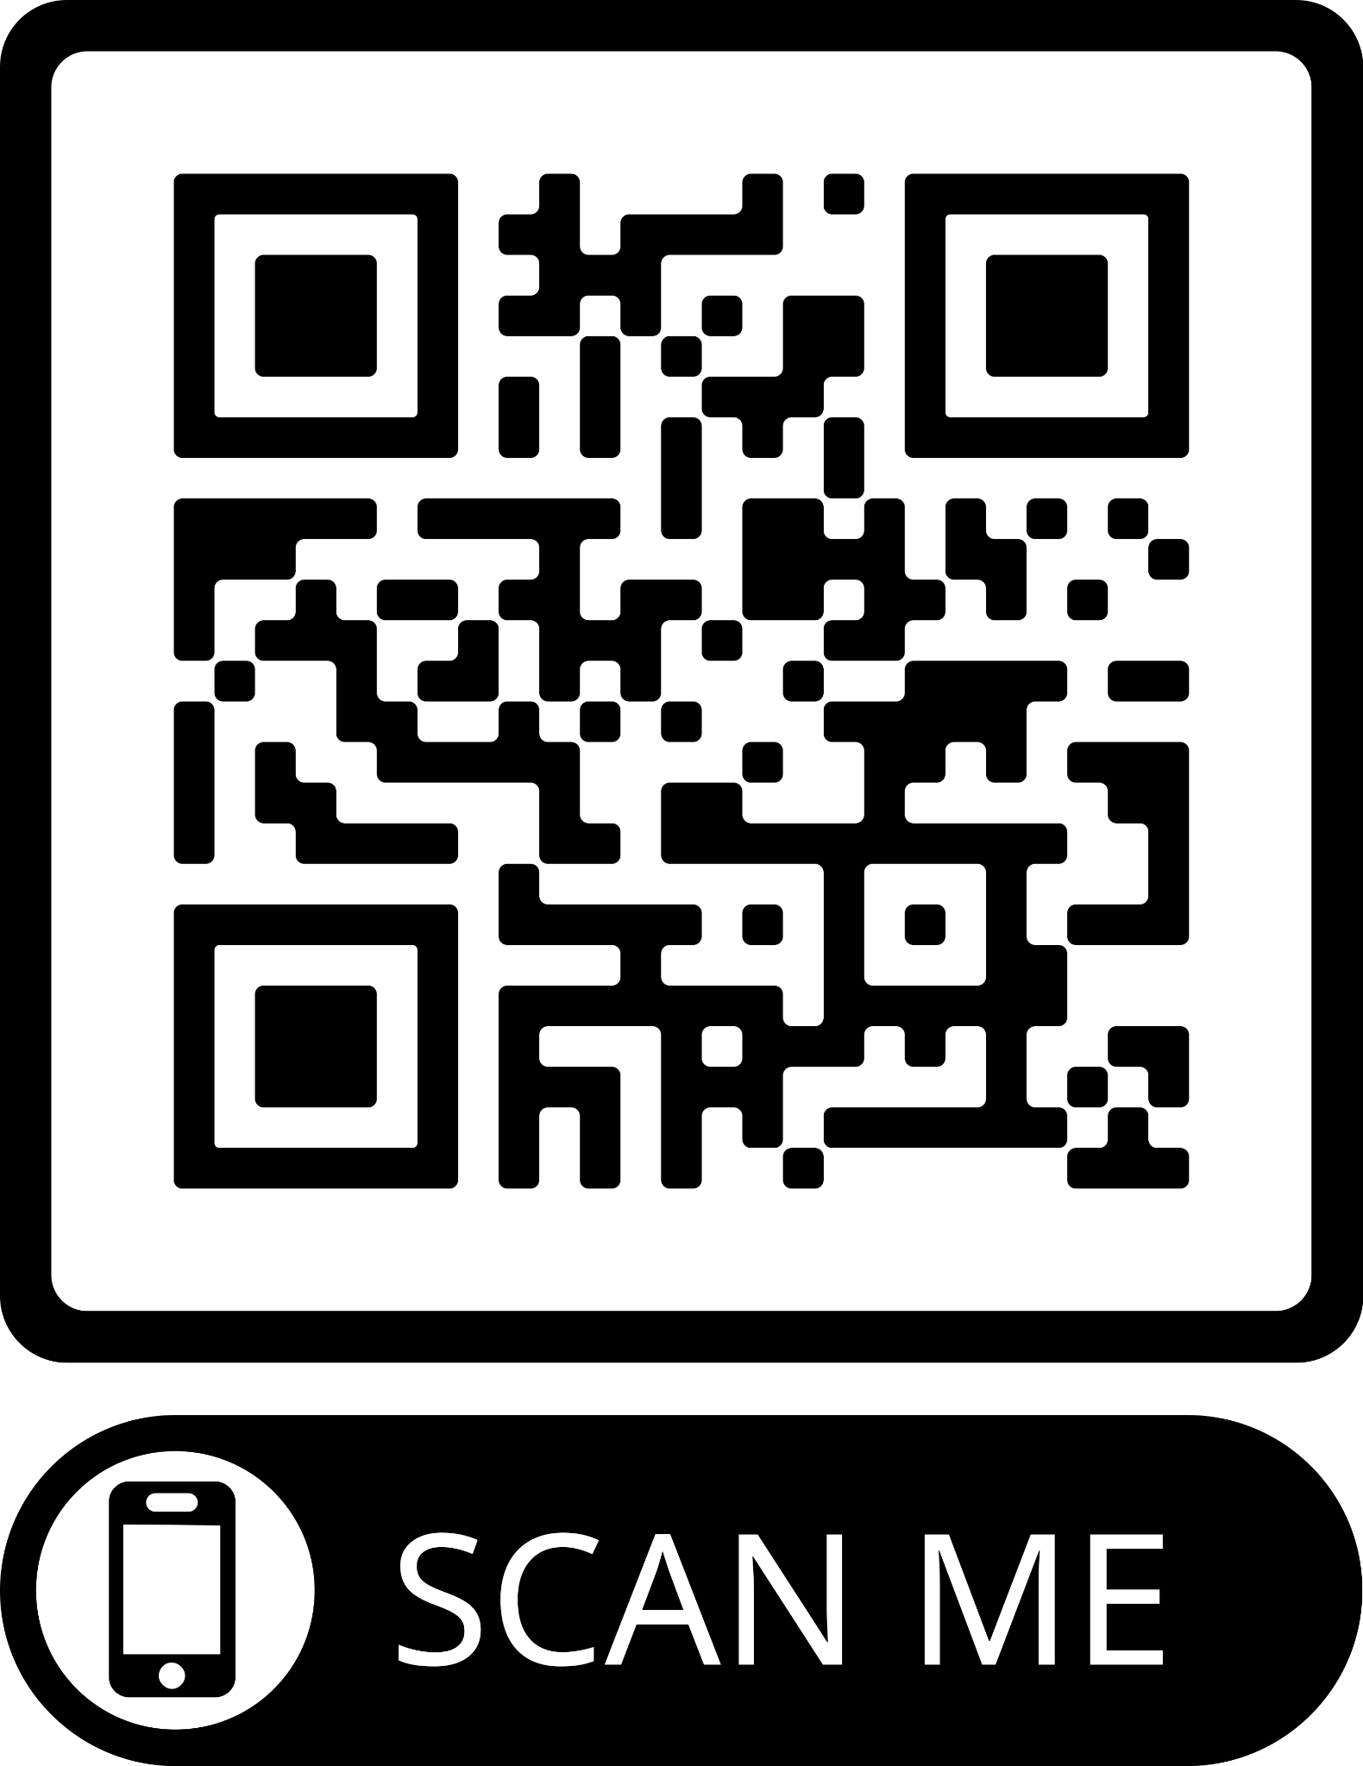
Pizza with the Principals
September 14th @ Summit Cafeteria 6pm-7pm
November 9th @ Livingston Cafeteria 6pm-7pm
February 1st @ Summit Cafeteria 6pm-7pm
Goal: To provide transparency and to work cooperatively as parents and principals for the success of our students
Notes:
Schyvonne

Slide 7
Student Code of Conduct
TIER 1
TIER 2
TIER 3
Tardies
Insubordination
Skipping
Academic Misconduct
Disruption of Class
Public Display of Affection
Dress Code
Horseplay
School Disruption
Repeated Offenses
Persistent Disorderly
Gambling
Bullying/Harassment
Possession of Unauthorized Devices
Tobacco
Threatening Behavior
Theft
Fighting
Drugs
Sex/Sexting
Alcohol
Assault
Dangerous Weapons
Classroom
ISS/1-9 Days OSS
10 Days OSS & Recommendation for Expulsion
Notes:
Madeline

Slide 8
Cell Phones & Dress Code (Bennett)
23/24 Student Handbook
Dress code can be found on page 90.
head coverings, unless religious or medical
midriffs
no drug or alcohol representation
Cell phone policy can be found on page 94.
All technology, to include personally owned electronic devices (cell phones, iPods, tablets and similar devices) brought into the schools must only be used to support education and research and be consistent with the objectives of the district. All personal electronic devices must be turned off, kept secured, and out of sight during the school day. A student shall not use a personal electronic device during instructional time unless expressly permitted while under the supervision and direction of school staff.
Not to be used during instructional time
Do not record fights or other poor behavior
Bullying via Social Media
Empowering leaders who impact the NOW and innovate the FUTURE
Notes:
Schyvonne

Slide 9
Student Code of Conduct
VAPING
Notes:
Baylis

Slide 10
PowerSchool & Echo
Notes:
Yvonda

Slide 11
Closing Remarks
Notes:
Baylis

Slide 12
Thank You
Empowering leaders who impact the NOW and innovate the FUTURE

